Slide 1
Coping & Resilience

Slide 2
Important Terminology
Stress moderators – factors that modify how stress is experienced
Ex: coping skills, financial security, social support
Coping– managing the internal and external demands of stressful situations using thoughts and behaviors
Coping strategies can be helpful or maladaptive
Negative affectivity (also called neuroticism) – a pervasive negative mood marked by anxiety, depression, and hostility; often leads to increased distress and worse health outcomes
Resilience – the psychological fortitude that helps a person respond, adapt, and recover from stress

Slide 3
Coping Style
Coping style – the approach a person typically utilizes when processing stress
Avoidance-oriented coping vs approach-oriented coping
Avoidance-oriented coping – a coping style where a person will push away stressor-related thoughts and feelings, deny the existence or seriousness of the stressor, or distract oneself
Approach-oriented coping – a coping style where a person makes an effort to solve the problem, seek support, and actively reframe the stressor towards the positive
Leads to better health outcomes
Problem-focused coping vs emotion-focused coping
Problem-focused coping – attempting to do something constructive about the stressful conditions.
Emotion-focused coping – regulating emotions experienced because of the stressful event.

Slide 4
Maladaptive Coping Mechanisms
At the core of the problem, people don’t want to hurt or feel stressed. Many “bad” behaviors are completed because they can provide the fastest relief (even if they only make problems worse in the end).
Common avoidance-oriented coping mechanisms:
Avoiding the person/ scenario/ task
Procrastination
Excessive sleeping or eating
Substance use

Slide 5

Healthier Approaches to Coping

Slide 6

Mindfulness Meditation
Teaches individuals to:
Have greater awareness of the present.
Focus on the present and accept it.
Dialectical Behavior Therapy (DBT) – a variation of CBT that incorporates mindfulness training
Developed for treating Borderline Personality Disorder, but has been successful in treating anxiety, depression, PTSD, and substance use disorders

Slide 7
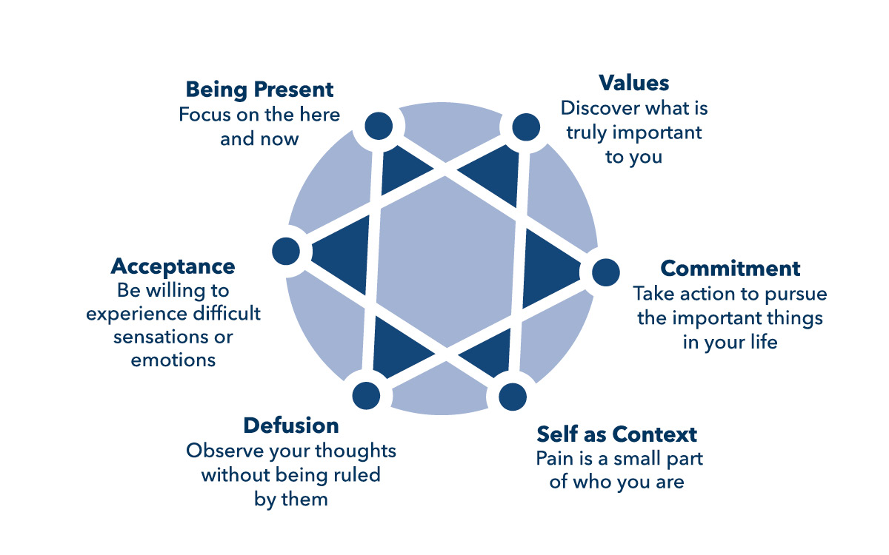
Acceptance and Commitment Therapy
Promotes flexibility and pursuit of values and goals rather than constant striving to eliminate or escape life’s troubles.
Incorporates mindful awareness and acceptance.

Slide 8

Expressive Writing
Writing one’s deepest thoughts and feelings about a traumatic or stressful event.
Has been shown to improve psychological and physiological indicators of stress and direct indicators of health (for example, wound healing)
Variation: dream scripts and lucid dreaming

Slide 9
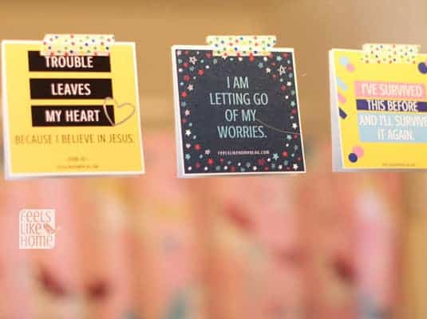
Self-Affirmation
Self-affirmation – when people positively affirm their values
Has a wide variety of effects, including:
Helps individuals feel better about themselves.
Lowers physiological activity and distress.
Reduces defensive reactions to health threats.
This Photo by Unknown Author is licensed under CC BY-NC-ND

Slide 10

Relaxation Training
Relaxation training – reducing arousal by influencing the physiological experience of stress
Progressive muscle relaxation
Deep breathing & square breathing
Guided imagery
Yoga

Slide 11
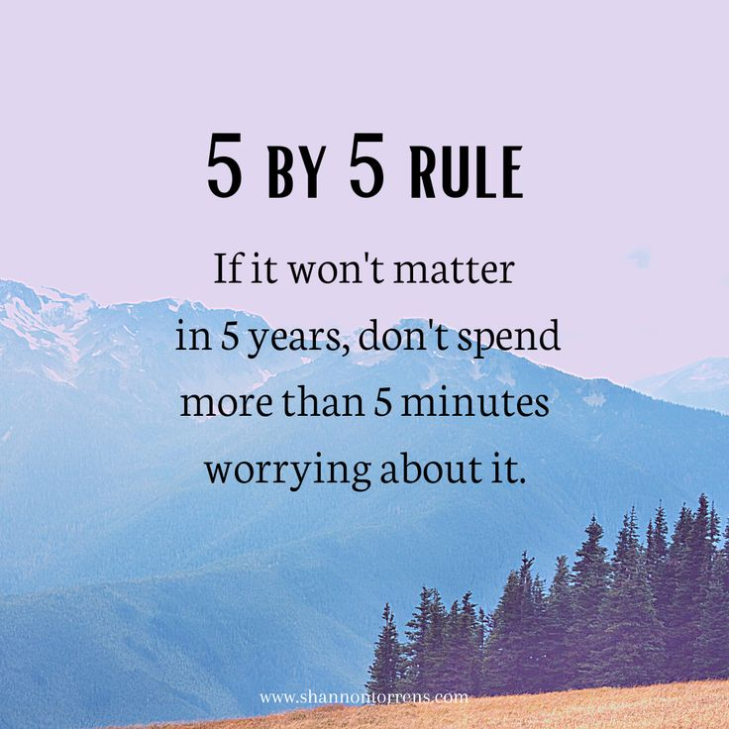
Coping Skills Training
Create stress management programs, which involve three phases:
Learning and identifying stressors
Training stress coping skills
Practicing the techniques
Techniques often include aspects like time management/ planning and how to change self-talk

Slide 12
Social Support
Social support – information from others that one is loved and cared for, esteemed and valued, and part of a network of communication and mutual obligations.
Multiple types of support:
Tangible assistance (services, finances, material goods)
Informational support
Emotional support
Invisible support
Direct effects hypothesis – social support is generally beneficial during non-stressful as well as stressful times.
Buffering hypothesis – physical and mental health benefits of social support are chiefly evident during periods of high stress.

Slide 13
Social Support Outcomes
Lowers physiological and neuroendocrine responses to stress.
Decreases cortisol responses to stress.
Better immune functioning.
Modifies the brain’s responses to stress.
Lowers the likelihood of illness.
Speeds up recovery.
Reduces the risk of mortality.
Encourages individuals to use health services and stick to their medical regimens.
Can lead to some bad health habits.

Slide 14

Social Support – The Balance
Provide support that meets the needs of a stressful event
Respect the person, being careful not to control, direct, or cross boundaries

Slide 15
Resources
Dr. Daby’s therapeutic yoga free videos: https://nydiasyogatherapy.com/free-video-training-programs/#videos
Relax With Animal Facts podcast: https://open.spotify.com/show/6AZ2VyITjVYFvygseqcLpp?si=72c96a40ba884184

